Slide 1
PLASMA PROTEINS
MLS 331

Slide 2
INTRODUCTION
Proteins are high molecular-weight polypeptides made up of amino acids joined by peptide bonds.
The plasma proteins are of major diagnostic importance out of proteins contained in various fluids of the body.
The most abundant plasma proteins are mainly proteins secreted by the liver or by B lymphocytes.
The human plasma proteins are a mixture of simple proteins such as albumins and conjugated proteins such as glycoproteins, lipoproteins etc.
Albumin is regarded as the single most important quantitative plasma protein.
Most of the other plasma proteins are collectively grouped as globulins.
Physiological /disease conditions leads to changes in plasma protein concentrations whose measurements provide necessary diagnostic information.

Slide 3
PHYSIOLOGIC FUNCTIONS
There are various functions carried out by plasma proteins and they include:
Buffering action - all proteins are amphoteric and thus can combine with acids and bases to buffer the body system which is pH dependent.
Transport - Albumin and some specific binding proteins transport hormones, bilirubin, and drugs.
maintenance of oncotic pressure - all proteins especially Alb exert a colloid osmotic effect which influences the distribution of water between ECF and ICF compartments.
As enzymes - enzymes are proteins.
Body defense - immunological functions e.g. gamma globulins.
Nutritive function - as simple proteins and a good source of protein, these contribute a.a for tissue protein synthesis.
As scavengers e.g. haptoglobin is a scavenger Hb.

Slide 4




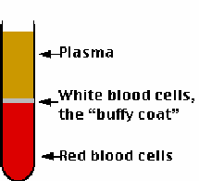


Plasma - blood treated with anticoagulants to prevent clot
formation then centrifuged to remove the cells
Plasma
Plasma
"Buffy coat"
Red blood cells
Serum - blood that is allowed to form a fibrin clot then
centrifuged to remove the cells and the clot

Slide 5
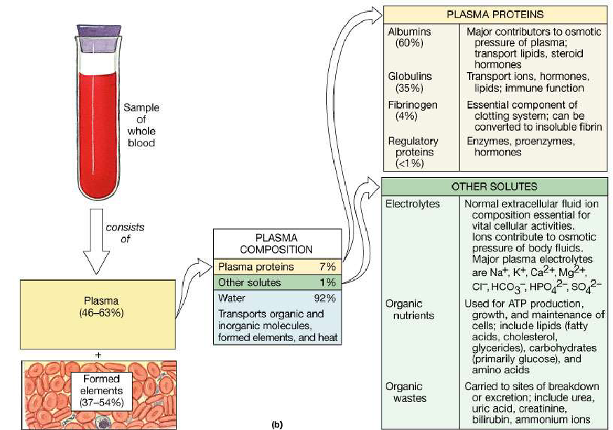
The Composition of Whole Blood
Figure 19.1b

Slide 6


Plasma proteins
include proteins of blood plasma and
proteins of interstitial fluid
almost all are glycoproteins
some groups of proteins are classified
separatelly (enzymes, proteohormones)
" total protein " ~ more than 300 proteins

Slide 7

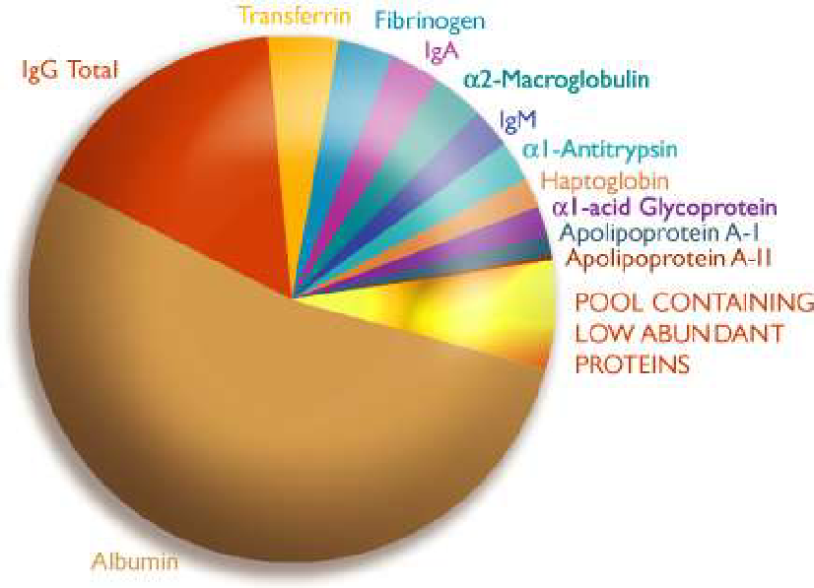
Individual proteins of blood plasma
The figure is from http://www.beckmancoulter.com/products/instrument/protein/proteomelab_igy_dcr.asp (Feb 2007)

Slide 8
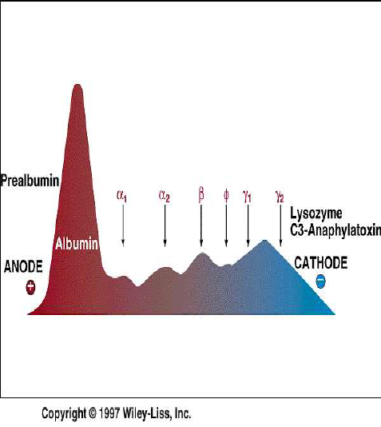

Classification of plasma proteins
by
electrophoretic
mobility
prealbumins
albumin
alpha, beta and
gamma-globulins
fibrinogen
The figure is from textbook: Devlin, T. M. (editor): Textbook of Biochemistry with Clinical Correlations, 4th ed.
Wiley-Liss, Inc., New York, 1997. ISBN 0-471-15451-2

Slide 9
by specific function
transport proteins
proteins of immune system
system of proteases and antiproteases
proteins of hemocoagulation system
signal proteins
enzymes
cellular proteins

Slide 10
by clinical use
Cardiomarkers
Tumormarkers
Acute phase reactants
Enzymes
Hormones
Cytokines

Slide 11

General properties of plasma proteins
Most are synthesized in the liver
exception: -globulins - synthesized in plasma cells
Synthesized as pre-proteins on membrane-bound polyribosomes;
then they are subjected to posttranslational modifications in ER
and Golgi apparatus
Almost all of them are glycoproteins
Exception: albumin
They have characteristic half-life in the circulation (albumin - 20
days)
?
? Many of them exhibit polymorphism
(immunoglobulins, transferrin. )

Slide 12

Factors influencing concentration
of proteins
total protein: 64 - 83 g/l
rate of synthesis and degradation
distribution in body fluids
loss into the interstitial space
elimination from the body
hydration of the body

Slide 13

other important factors:
elevation of concentration before taking
blood sample
body position (In supine position)
tightening of arm
storage of biological specimens

Slide 14

Physiological variability
increased concentrations
?
plasma > serum (fibrinogen)
?
stand-up position (by 10-15 %)
?
increased muscle activity (by 12 %)
?
dehydration
decreased concentrations
1- children, pregnant women
2- after starvation (albumin, transferrin, C3)

Slide 15




Regulation of synthesis
INCREASE
DECREASE
?
inflammation
# liver damage with
?
hyperthyroidism
parenchymal
tissue
?
hypercortisolism
# nutritional deficit
?
Growth hormone
# hypothyroidism
?
iron deficiency
# diabetes mellitus
?
clonal production
# alcoholism
of Ig
# protein loss

Slide 16
Methods of separation
Precipitation by SALTING OUT:
Different concentration of salt solutions are used to
precipitate different concentration of protein.
Salts most commonly used
- Ammonium sulphate solution
-Mixture of Sodium Sulphate and Sodium Sulphite
1- On 1/5th saturation with ammonium sulphate
FIBRINOGEN is best precipitated.
2- On 1/3 rd saturation globulin starts precipitating. It is
called Euglobulin.

Slide 17
? On « saturation total globulin is precipitated out. It is
called Pseudoglobulin.
? Albumin is precipitated out by full saturation.
Fractionation of plasma proteins by ETHANOL [Cohn's
Fractionation]
Varying concentration of ethanol at low temperature
Cohn's Fractions
Fraction I rich in Fibrinogen
Fraction II
αglobulin
Fraction III α 1 and α 2 globulins
Including isoaglutinnin &
prothrombin
Fraction IV
β 1& β2 globulins
Fraction V
albumin

Slide 18
Advantage of this fractionation
1- Ethanol that is used for separation can be readily
removed by evaporation.
2- Being a mild procedure it does not cause
denaturation of protein.
3-Clinically Cohn's method is used for obtaining purified
proteins on large scale for therapeutic purpose.
ELECTROPHORESIS:
Initially paper electrophoresis was used.
Nowadays agar gel electrophoresis, cellulose acetate
membrane electrophoresis, immunoelectrophoresis is
used.

Slide 19
ALBUMIN
plasma.
Albumin (69 kDa) is the major protein of human
Normal level is 3.5 - 5.5g/dL
Makes up approximately 60% of the total plasma
protein.
About 40% of albumin is present in the plasma, and
the other 60% is present in the extracellular space.
The liver produces about 12g of albumin per day.
The gene for albumin is situated at chromosome no. 4

Slide 20
Albumin is synthesized by hepatocytes as preproalbumin. Its signal
peptide is removed, converting it to proalbumin. In
turn, proalbumin, while inside transport vesicles, is converted to
albumin by action of furin.
Signal
Peptide
Furin
Preproalbumin
Signal Peptide
Hexapeptide
+
+
Proalbumin
ALBUMIN
Furin is a enzyme that cleaves a hexapeptide from proalbumin
immediately C-terminal to a dibasic amino acid site (Arg). The
resulting mature albumin is secreted into the plasma.
The synthesis of albumin decreases relatively early in conditions of
protein malnutrition, such as kwashiorkor.
In liver diseases the synthesis of albumin is depressed (decrease in
albumin/globulin ratio).

Slide 21
Structure and Functions of Albumin
Mature human albumin consists of one polypeptide chain
(simple protein) of 585 amino acids and contains 17
disulfide bonds.
Albumin has an ellipsoidal shape, which means that it does
not increase the viscocity of the plasma.
Because of its relatively low molecular mass (about 69 kDa)
and high concentration albumin is thought to be
responsible for 70-80% of the osmotic pressure of human
plasma.
By the use of proteases, albumin can be subdivided into
three domains, each have different functions.
.

Slide 22
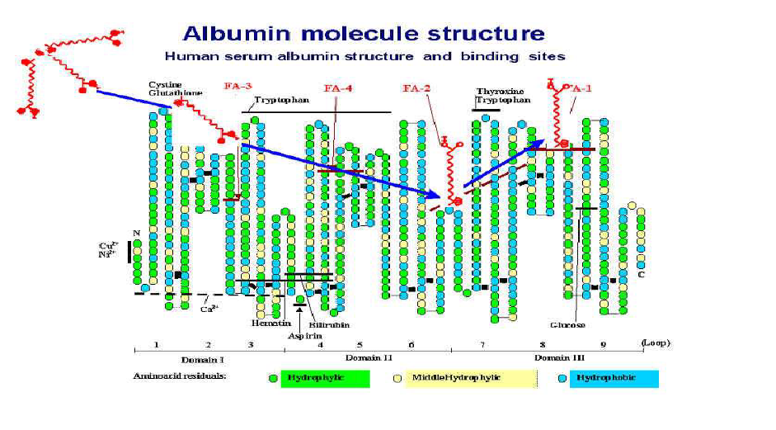
Functions of Albumin
maintenance of colloidal oncotic pressure
Transport of long chain fatty acids & sterols
Transport of bilirubin
Binding and solubilization of drugs

Slide 23
Hypoalbuminemia
Low blood albumin levels (hypoalbuminemia) can be
caused by:
Liver disease; cirrhosis of the liver is most common
Excess excretion by the kidneys (as in nephrotic
syndrome )
Excess loss in bowel ( protein-losing enteropathy )
Burns ( plasma loss in the absence of skin barrier )
Redistribution ( hemodilution [as in pregnancy])
phase protein )
Acute disease states (referred to as a negative acute-

Slide 24
Hyperalbuminemia
-Due to severe or chronic dehydration and high
protein diets.
- Chronic dehydration needs to be treated with
zinc as well as with water.
- Zinc reduces cell swelling caused by increased
intake of water (hypotonicity) and also increases
retention of salt.
-In the dehydrated state, the body has too high in
osmolarity and, it discards zinc to prevent this.

Slide 25
GLOBULINS
α-globulins:
Further classified into α1 and α2 globulin according
to electrophoretic mobility.
α1 acid glycoprotein:
? Also called orosomucoid
? Normal level 0.6 - 1.4 gm/L
? Carbohydrate content is about 41%
? Considered as a reliable indicator of acute
inflammation
? binds to progesterone hormone and transport it.

Slide 26
α - fetoprotein:
Present in high conc. in fetus particularly in mid
pregnancy.
Normal adult level < 1ug /dL.
Potential tumour marker of hepatocellular
carcinoma.
Forms the basis of TRIPLE test of screening for
DOWNS syndrome.

Slide 27


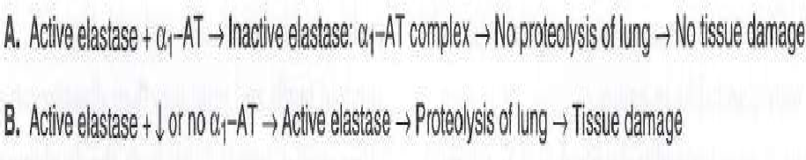
α 1-ANTITRYPSIN
1 -Antitrypsin
(about 52 kDa) is a single chain protein
of 394 amino acids, contains three oligosaccharide
chains.
It is synthesized by hepatocytes and macrophages
and is the principal serine-protease inhibitor
of human plasma.
Inhibits trypsin and elastase.

Slide 28

Deficiency of Antitrypsin-I
At least 75 polymorphic forms occur, many of which
can be seperated by electrophoresis.
A deficiency of this protein has a emphysema.
.
When the amount of 1 -antitrypsin is deficient and
polymorphonuclear white blood cells increases in
the lung (eg, during pneumonia), the affected
individual lacks a countercheck to a proteolytic
damage of lung by proteases such as elastase.

Slide 29

CERULOPLASMIN [ α -2 globulin]
Conc. in plasma: 300 mg/L
It is a glycoprotein with enzyme activity ( copper
oxidase, histaminase, ferrous oxidase )
Functions:
carries 90% of copper in plasma (copper - cofactor for a
variety of enzymes);
1 molecule binds 8 atoms of copper; [« as cuprous and « as
cupric ]
of copper
binds copper more tightly than albumin that carries other 10%
albumin may be more important in copper
transport (donates copper to tissues more readily)

Slide 30




:
Liver diseases, in particular Wilson's disease:
- genetic disease in which copper fails to be excreted into the bile
and accumulates in liver, brain, kidney, and red blood cells
- cause: mutations in the gene encoding for copper-binding
ATPase
consequences:
accumulation of copper in liver, brain, kidneys.
disease, neurologic symptoms
coupling of copper to apoceruloplasmin results in
low plasma
levels of ceruloplasmin
Causes of ceruloplasmin increase:
1- Inflammatory states
2- Carcinomas, leukaemia
3- Rheumatoid arthritis

Slide 31
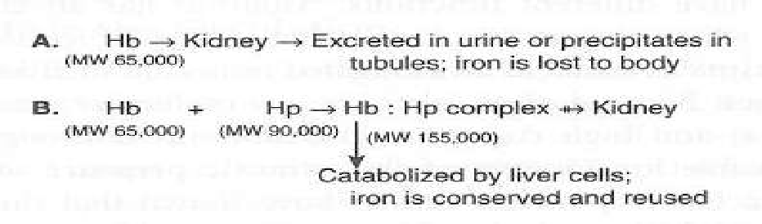
HAPTOGLOBIN (Hp) [ α -2 globulin]
extracorpuscular hemoglobin (Hb) in a tight noncovalent
Haptoglobin (Hp) is a plasma glycoprotein that binds
complex (Hb-Hp). Haptoglobin binds to extracorpuscular
hemoglobin, preventing free hemoglobin from
entering the kidney.
Hb-Hp complex is too large to pass through the glomerulus. The
function of Hp thus appears to be to
prevent loss of free Hb into the kidney.
Different fates of free hemoglobin and of the Hb-Hp complex

Slide 32
Functions of Haptoglobin
The function of Hp thus appears to be to
prevent loss of free Hb into the kidney.
This conserves the valuable iron present in
hemoglobin, which would
otherwise be lost to the body.

Slide 33
β -GLOBULIN
Haemopexin:
Level is very low at birth but reaches adult value by
first year of life.
normal value: 0.5 - 1.0 g/L
bind and remove circulating haem which is formed
in the body from breakdown of Hb
, myoglobin or catalase.
decrease in hemolytic disorders.

Slide 34
TRANSFERRIN
Transferrin (Tf) is a β 1 -globulin with a molecular mass of
approximately 76 kDa.
It is a glycoprotein and is synthesized in the liver.
About 20 polymorphic forms of transferrin have been
found.
Transferrin plays a central role in the body's metabolism of
iron because it transports iron
(2 mol of Fe 3+ per mole of
Tf) in the circulation to sites where iron is required, eg,
from the gut to the bone marrow and other organs.

Slide 35

Causes of transferrin deficiency:
?
Burns
?
Infections
?
Malignancies
?
Liver and kidney diseases
:
?
Iron-deficiency anaemia

Slide 36
C-reactive protein (an acute-phase protein)
- It is a protein found in the blood, the levels of which
rise in response to inflammation.
- Its role is to bind to phosphocholine on the surface of
dead or dying cells and some types of bacteria to
activate the complement system.
- CRP is synthesized by the liver in response to factors
released by adipocytes
-It is used mainly as a marker of inflammation and in
cancer, which is not clear until now.
- Measuring CRP values by ELISA, rapid
immunodiffusion and visual agglutination is useful in
determining disease progress or the effectiveness of
treatments.

Slide 37
β -2 MICROGLOBULIN
-Present In urine to the extent only 0.01mg/ dL
-Close resemblance with immunoglobulins.
Increased in renal disease and it is a reflection of
impairment of function of glomerular
membrane or renal tubules.
Now receiving much attention as a tumour marker.
Useful to check renal damage

Slide 38
Fibrinogen (0.2-0.45 g/dl)
representing 4% of plasma proteins
-It is a soluble plasma glycoprotein, that is
converted by thrombin into fibrin during blood
coagulation.
-This is achieved through processes in the
coagulation cascade that activate the zymogen
prothrombin to the serine protease thrombin,
which is responsible for converting fibrinogen into
fibrin, which is then cross linked by factor XIII to
form a clot.

Slide 39


α-2 MACROGLOBULIN
2 -Macroglobulin
is a large plasma
glycoprotein (720 kDa) made up of 4
identical subunits of 180kDa.
Approximately 10% of the zinc in plasma is
transported by 2 - -2 macroglobulin the
remainder being transported by albumin.

Slide 40
METABOLISM OF PLASMA PROTEINS
The amount of plasma proteins in the vasculature depends on balance between rate of synthesis and that of catabolism or loss.
SYNTHESIS
Synthesis of most plasma proteins occurs in the hepatocyte which is controlled by specific regulatory mechanisms except the immunoglobulins which are derived from β-cells of the immune system. For example:
Albumin synthesis depends upon the oncotic pressure in the hepatic ECF.
Synthesis of many proteins involved in inflammation is controlled by humoral factors released from macrophages.
The supply of a.a stimulates the synthesis of some plasma proteins in the liver.
Several hormones have important effects not only on the synthesis of plasma proteins but on their distribution and catabolism.

Slide 41
CATABOLISM
Occurs when the proteins are taken up by pinocytosis into the capillary endothelial cells, or into mononuclear phagocytes.
To a greater or lesser extent, breakdown of plasma proteins occurs in most cells of the body.
All capillary endothelial cells are capable of degrading plasma proteins during pinocytic transport across the cells, which then releases a.a used by tissues - main mechanism of Alb catabolism.
Those plasma proteins which contains CHO side-chains e.g transferrin, are probably catabolized largely in the liver.
Passive loss occurs when the renal glomerulus filters low m.w proteins and protein fragments (about 2-4g of plasma proteins produced by proteolysis daily) which are then reabsorbed and catabolized in the proximal tubules.
Several proteins, such as IgG and complement proteins, are broken down within macrophages as a result of forming complexes or cleavage products which are phagocytosed or pinocytosed following binding to receptors.

Slide 42
FACTORS AFFECTING SYNTHESIS AND CATABOLISM
Defective anabolism which may be due to:
reduced synthesis in liver disease
impaired intake of proteins as in malnutrition
defective digestion or malabsorption as in carcinoma of the stomach or pancreas, peptic ulcer.
Increased catabolism as found in:
fever and after injury
severe haemorrhage or early stage of shock
acute infections in untreated DM and hyperthyroidism

Slide 43
TOTAL PLASMA PROTEINS
Total protein concentrations are likely to be altered significantly only when there are marked changes in its major constituents, such as Alb and immunoglobulins.
Their estimation in the laboratory therefore provides clinically useful information in only limited number of disease conditions.
The measurement of total protein content of the plasma may be used to assess degree of hydration of the patient and is required if the calculation of the total globulin is to be made.
Globulins (g/dl) = Total protein (g/dl) - Albumin (g/dl)
Total protein content is most commonly measured by the biuret technique which depends on a colour reaction between an alkaline copper reagent and the CO-NH peptide linkages.
The reference range for total protein is 60 - 80g/l (6.0 - 8.0g/dl), estimated in serum; this excludes fibrinogen, which is included in plasma.

Slide 44
LABORATORY METHODS FOR TOTAL PROTEINS
Laboratory investigations for total proteins is based on any of the following principles:
Nitrogen estimation - standard procedure based on Kjeldhal.
Estimation of tyrosine in protein - as in lowery's method.
Biuret method - most commonly used method in clinical practice and in autoanalyzer.
Biuret method principle: substances with two or more peptide links and those that contain two -CONH2 groups give a blue to purple coloured compound with alkaline copper solution.
The measurement of TP is of limited value as:
It may be altered by changes in plasma volume. An increase is caused by dehydration and a decrease by overloading with water.

Slide 45
Conc of TP is higher when a person is standing than when recumbent.
A short spell of vigorous exercise increases the TP conc by 5 to 10%.
Excessive stasis while taking the blood specimen also increases the value.
Some anticoagulants withdraw water from rbc resulting in similar protein conc in both plasma and serum inspite of fibrinogen present in the former.
Increase in TP is usually due to an increase in total globulins with the conc of Alb remaining normal or decreasing marginally.
A decrease in TP conc is usually the result of a fall in albumin and sometimes gammaglobulins.
In these A:G ratio change due to either reduction of albumin or elevation of globulins.
Elevated levels of TP are associated with:
dehydration due to vomiting and diarrheoea, MM, chronic liver dxs.
Decreased levels are found in:
renal dxs, malnutrition,albuminuria, terminal liver failure.

Slide 46
BCG method is used for the quantitative estimation of Alb. Under acidic conditions, Alb present in serum samples binds to bromocresol green to form a green coloured albumin-BCG complex whose intensity is measured at 630nm photometrically.
Determination of Albumin: Globulin Ratio:
Globulins can be precipitated by using 28% sodium sulphite solution.
The filtrate gotten after centrifugation contains Alb which is then treated with biuret reagent.
The intensity of the blue co;our formed is then measured. The difference between total protein and Alb gives globulin content.
To calculate the Alb/globulin ratio, divide the amount of albumin by that of globulin.
Total protein ranges from 6.0 -8.0g/dl
Albumin ranges from 3.5 - 5.0g/dl
Globulins ranges from 2.5 - 3.5g/l
A:G ratio varies from 1.5:1 to 2.5:1

